Slide 1
Internship Exit Presentation
+ Artificial Intelligence for ICAO
Hyuntae Jung
14th June, 2018

Slide 2


Introduction
Name
Hyuntae Jung
Background
Supervisor
Yuri Fattah
Air Traffic Control
Artificial Intelligence
Duration
Jan. ~ Jun. 2018 (6 months)
Worked with
Multidisciplinary Priorities
Integrated Aviation Analysis
Airspace Management and Optimization
+
Air Operation Assistant (ROK Air Force) – 2 years
Research Assistant (Korea & Japan) – 3 years

Slide 3
But… Why A.I.?
Why did an aviation guy studied A.I.?

Slide 4
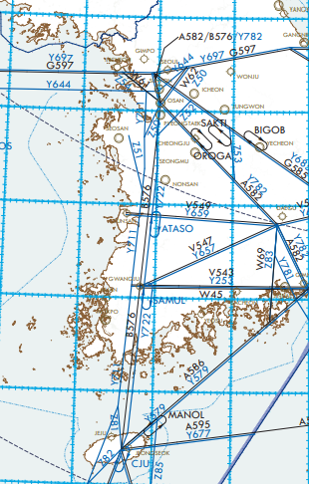
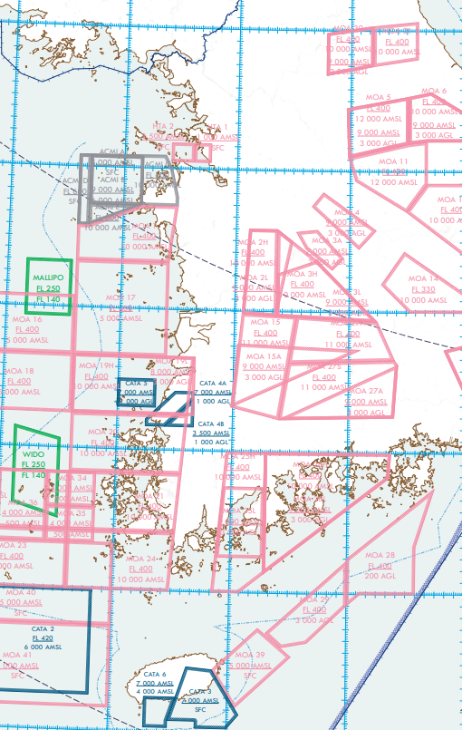
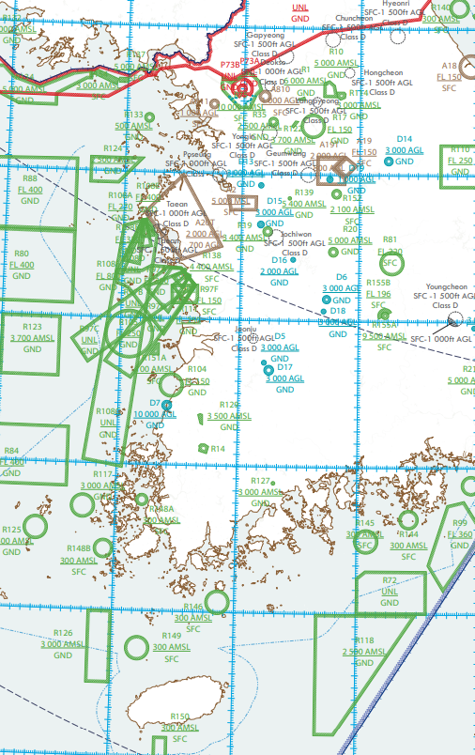
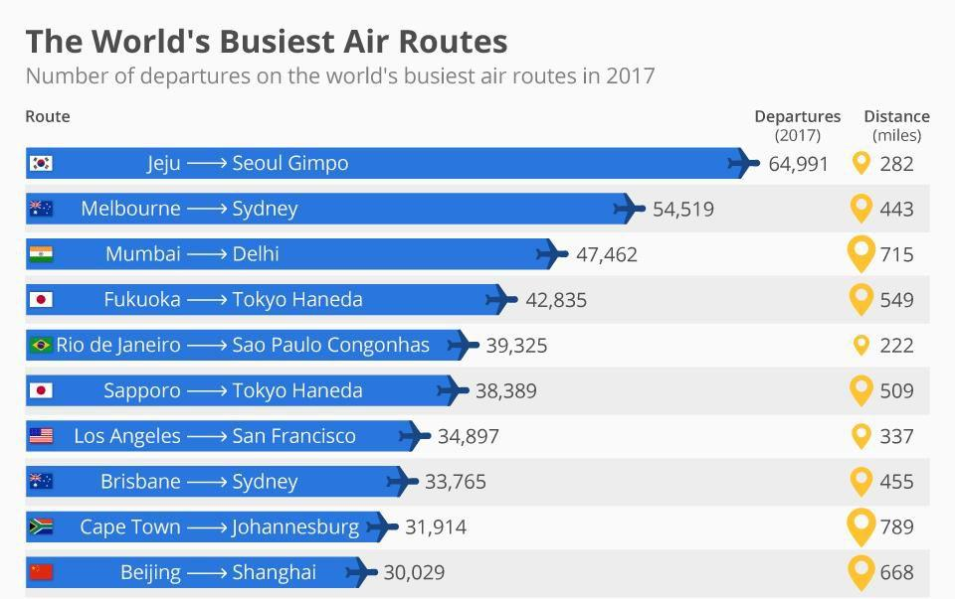
Background

Slide 5

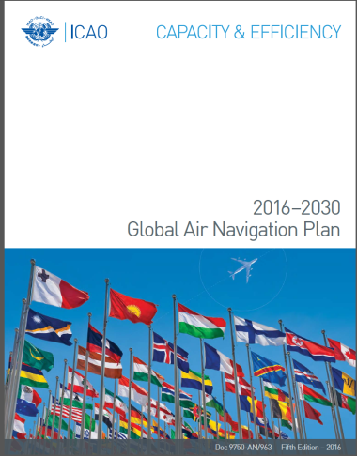
Background
Shouldn’t be there a better way to manage air traffic?
Air Traffic Management
Global Air Navigation Plan
Aviation System Block Upgrade
Student ATCo

Slide 6
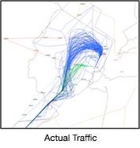
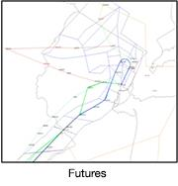
Trajectory Based Operation
TBO in Nutshell
4D flight trajectories are shared and managed…
“we know the accurate future traffic flow”
1
to all stakeholders
2
real-time data for Collaborative Decision Making
System-wide performance optimization
3
in advance and during the flight
Efficient, predictable, flexible operation
Full deployment planned in ASBU Block 3 (2031) & Block 4 (2037)

Slide 7


Trajectory Based Operation
TBO can be achieved with automation technologies
it is almost impossible for human to identify, track or manage every trajectories with low-level calculations.
Information Exchange
Capacity
Information
AU
ASP
ASP
even more machine support!
TBO
FF-ICE ?
FMS ?
Conventional Operation
Notes:
Handle information beyond human capacity: real-time big data exchange.
Automation required to coop and handle the explosive information.

Slide 8
A.I. is the game changer
Why?

Slide 9
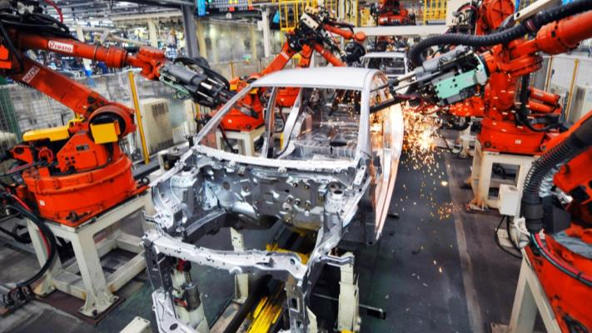
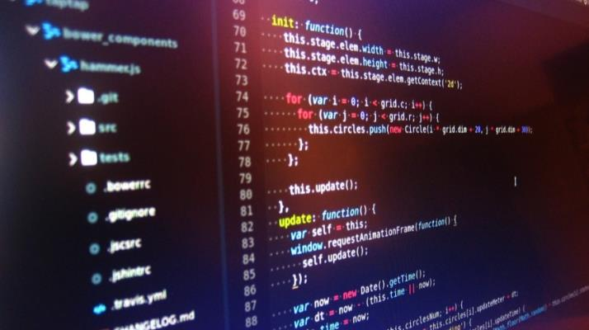
Automation
Artificial Intelligence
Mechanical Muscle
Mechanical Mind
Replacing repetitive human physical labor
Replacing repetitive human mental labor?
Stronger, reliable and more tireless than human muscle.
Better cost, time and accuracy
Theoretically, AI is capable of what human brains are capable of.
Only cost-effective in narrow situations

Slide 10
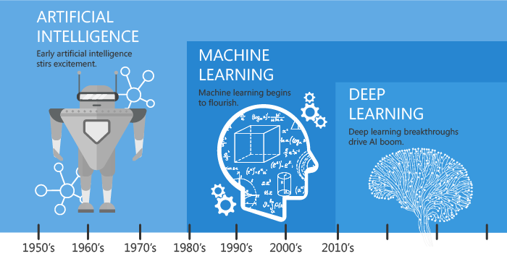

Slide 11
Traditional Expert System (~1990s)
Modern Machine Learning (2010s)
If…
Data
Predict
If…
If…
Action
Action
Action
Action
Architecture by human design, not data
Machine learns itself from huge data
Built to beat human performance
Built to mimic human decision
Once built, cannot improve without changing the architecture
Continuously evolve by feedback from data and prediction

Slide 12







A.I. in Nutshell:
Predict as similar as possible to actual result by capturing the pattern in data
Human behaviors
Data
AI Bot
Train & Evaluate
Validation

Slide 13

























However, the volume and complexity of information explosively increases.
Data exchange and management enabled real-time data sharing, network-wide operation and predictive safety management
A.I. would enable human to focus on final decision:
Go vs No Go.
The world used to be simple.
But information still relied on human actions.
capacity, integrity, interoperability and rapidity problem.
It is impossible to perform all of calculations by human
However, as the industry gets complex, it became impossible to follow with limited resources.
Decision Making
Decision Level
?
!
Capacity
/ Demand
Go vs No go problem
Process
Time
Strategic Planning
Intelligence Level
Problem Identification, Scenarios & Solutions
Solution: linking “status” to “action” from combined information.
Data-Driven Decision Making
Evaluation, Validation and Screening
Information Level
Status
Human-friendly, Processed information.
Predictions
Indicator
Statistics
Trend
Data Level
Data Exchange
Big-Data
Hardly readable, huge volume and real-time data
Reports
Reporting System
Field Level
Data Mining
Where real things are happening
Field

Slide 14
Internship in ICAO

Slide 15



Internship Goal:
The perspective from ICAO; the view of global governance.
Career goal:
Bridge the gap between Industry, Academia and Regulatory bodies.
Industry
Academia
Regulatory Bodies

Slide 16

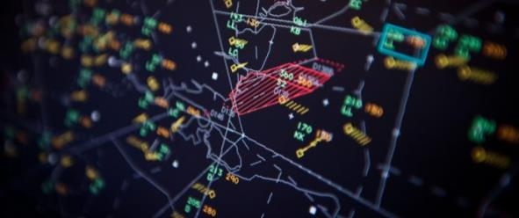

Explore the potential application of Artificial Intelligence in aviation.
Multidisciplinary Priorities
Airspace Management and Optimization
Integrated Aviation Analysis
Promote the public interest of Artificial Intelligence in ICAO
Assist secretariat in activities in the area of Trajectory Based Operation (TBO)
Develop preliminary Machine Learning applications for aviation data analysis

Slide 17

Multidisciplinary Priorities
Major Outputs
Drafting new project: building a decision support tools for a human-centric and sustainable aviation system. March 5th ~ 9th
Published two articles on illustrating A.I. application in aviation in unitingaviation.com. May 16th
Promote the public interest of Artificial Intelligence in ICAO
Participated in planning a ICAO’s Scientific Review of Artificial Intelligence in Civil Aviation (SRAICA). May 30th
→ The Artificial Intelligence can be used in ICAO services.

Slide 18

Airspace Management and Optimization
Major Outputs
Participation and assist in the 33rd meetings of the ATMRPP Working Groups (ATMRPP-WG/33), draft & present TMRPP-WG/33-WP/774: TBO website development. . March 19th ~ 23rd
ATMRPP/CP/IMP inter-panel Task Force. Apr 18th & May 2nd
Assist secretariat in activities in the area of Trajectory Based Operation
Global TBO concept video and TBO website for AN-Conf/13. May 3rd
→ Recognized how A.I. can applied into global TBO concept.

Slide 19
Integrated Aviation Analysis
Major Outputs
A.I. Bot: Criticality score evaluation and Q-code classification based on the NOTAM message. under-development
One-day workshop of Artificial Intelligence in ICAO. June 28th
Develop preliminary Machine Learning applications for aviation data analysis
Article for ITU’s Data for Good journal about ICAO’s data service. June 29th
→ The Artificial Intelligence can deliver more capabilities in aviation safety.

Slide 20




Artificial Intelligence for ICAO
Supporting decision making process
Artificial Intelligence for
Data-Driven Decision Making
Evaluate, Identify and driving solution
Document and context reading, summarization, conflict detection and writing
Artificial Intelligence for
ATM Configuration
Artificial Intelligence for
Safety Data Analysis
Enabler of future ATM concepts
Cost and time effective + high accuracy
Optimized resource allocation & maximized utilization of infrastructure
Continuous and predictive safety improvement through feedback

Slide 21
Why ICAO needs to consider Artificial Intelligence
→ Artificial Intelligence for international aviation community.
Opportunities
Threats
Justification
Can manage complexity through decision support tool.
Technological advancement will exceed the speed of how social or policy adapts.
The strategic objectives and No Country Left Behind initiative can be further achieved with the support of Artificial Intelligence.
Beneficial to bridge the gap between States: does not require heavy and expensive infrastructure
Enormous impact and concerns of representing only the specific interest of few people.
ICAO needs to protect equity by providing globally harmonized and open accessibility to the Artificial Intelligence for global aviation community.

Slide 22
What are the “real” benefits?

Slide 23





Artificial Intelligence and Strategic Objective
→ A.I. would be capable of supporting all of our works soon.
Predictive SMS
Maximize utilization of infrastructure
Risk-based management
Economic analysis and forecasting
Emission monitoring, evaluation and analysis
Continuous Monitoring
Anomaly detection
System Optimization
Resource Allocation
Modeling, simulation and prediction
Risk & Crisis analysis
Performance-based
Air Traffic Management
Joint data sharing and coordination
Face recognition + Biometric data
Implementation support
State support

Slide 24









Artificial Intelligence and No Country Left Behind
→ Building an A.I. is expensive, but using one is easy.
or almost
Researching
Building
Distributing
Using

Slide 25

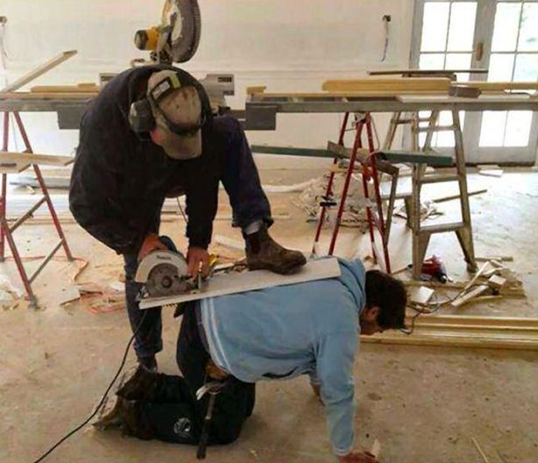

Slide 26
How to write a new paper (for humor)
Step 1.
Go read all the documents
Step 2.
Search for all potential conflicts
Step 3.
Discover a random item that you don’t really know about
Step 4.
Ask people for someone who know about it
Step 5.
Find out that they are on the vacation
Step 6.
Discover an ancient document that nobody actually cares, but conflicts with yours
Step 7.
Deal with random questions from those are unhappy about your idea
Step 8.
No idea what you are doing right now, but proceed anyway
Step 9.
Find out someone already did it
Too complex for A.I. to handle?
Complex works can be broken down into sets of simple tasks.

Slide 27
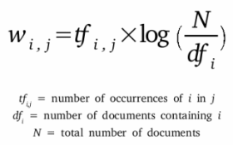
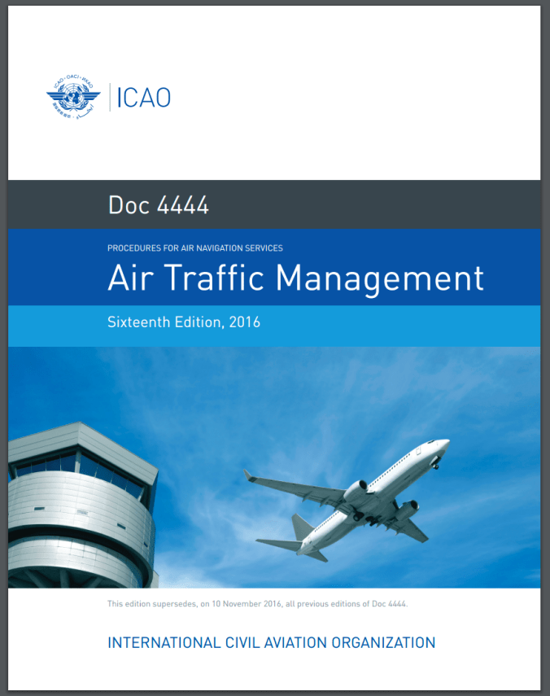
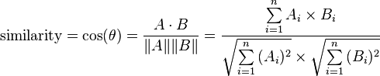
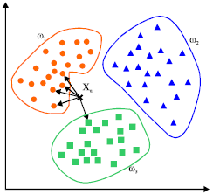
Example 1. ICAO Document Analysis
international standards and recommended practices air traffic control service flight information service alerting service doc 4444 sixteenth edition, 2016 air traffic management procedures for air navigation services…
the 9056 0.5890
and 2896 2.0352
in 2482 0.2471
aircraft 2041 0.3323
shall 1217 0.8951
flight 1071 1.5805
traffic 927 5.2799
control 746 1.9639
information 667 5.3957
Count words & Calculate TF-IDF

Slide 28
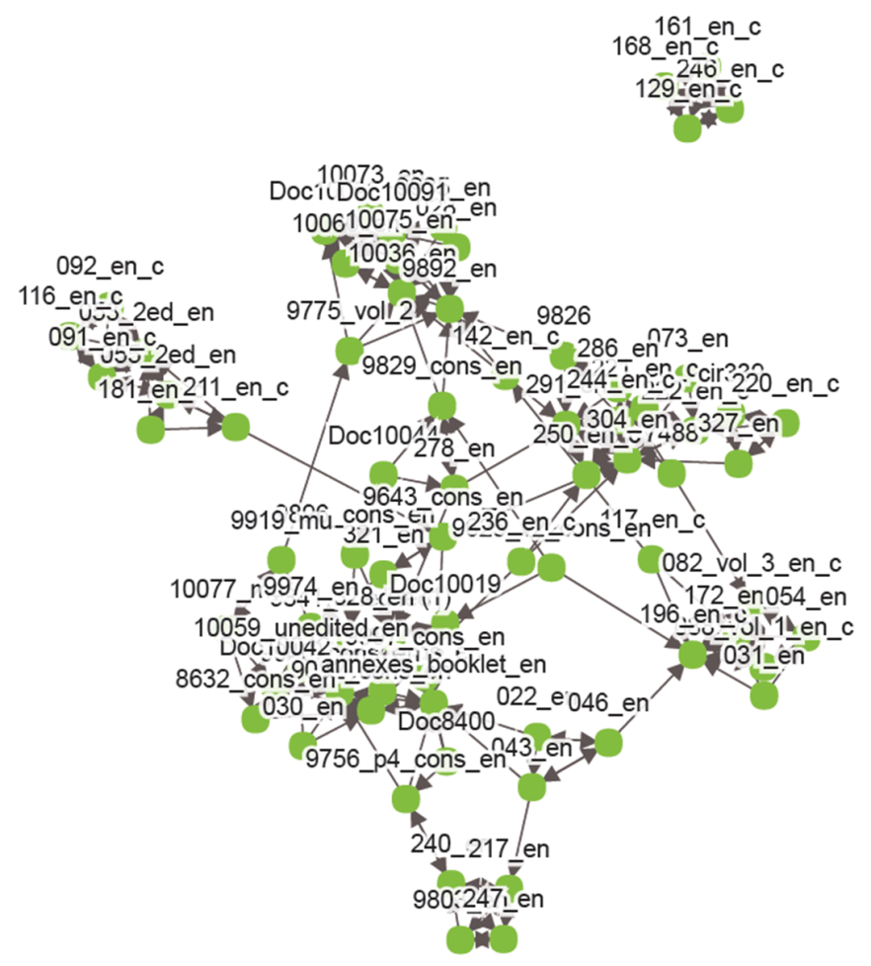
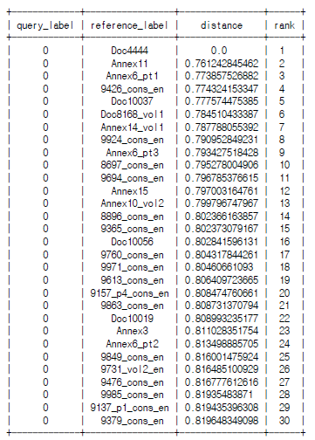
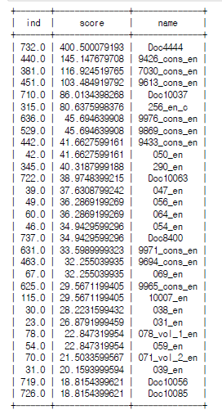
Document distance
Example: PANS-ATM (Doc 4444)
Keyword approach
Example: “flight plan”

Slide 29
Example 2. Fake Report Generator
… the future development of international civil aviation …
… the future development of international civil _viation …
t
t
8%
c
f
13%
blank
a
v
r
v
t
r
67%
a
32%
i
5%
m
m

Slide 31
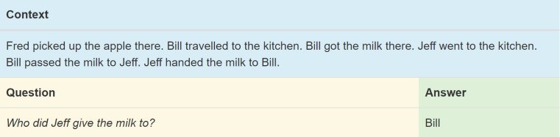
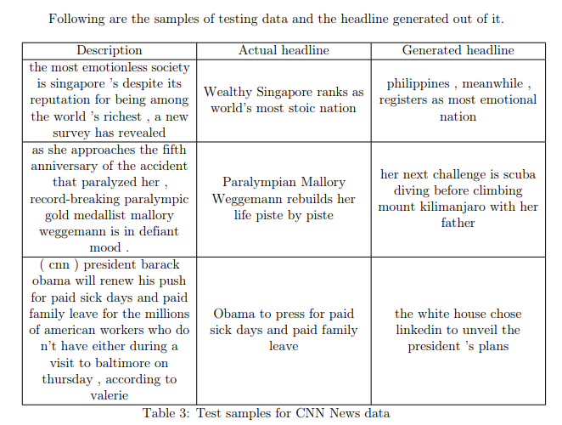
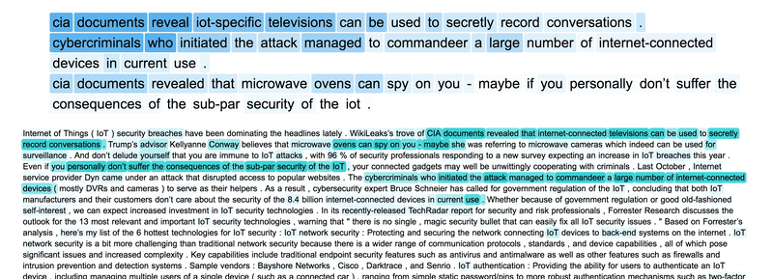
Question & Answering
Headline / Title
Summarizing

Slide 32
What do we need?

Slide 33





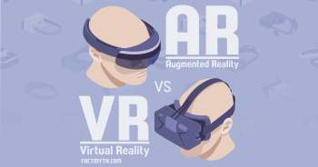

Data, Data and more Data
→ Data is the fuel of A.I.
Data Source
Accessible Data
Artificial Intelligence
Human-Machine Interface

Slide 34
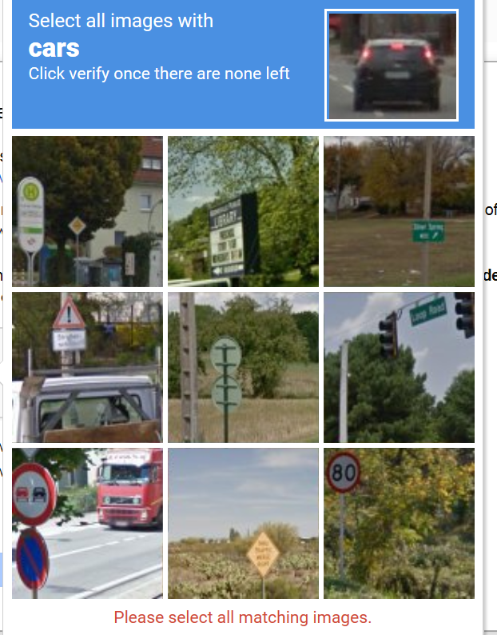
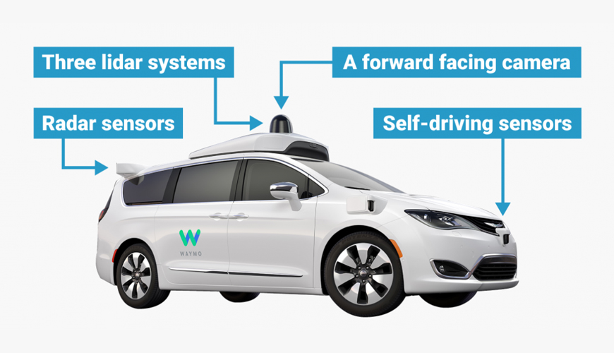

Slide 35
Challenges

Slide 36

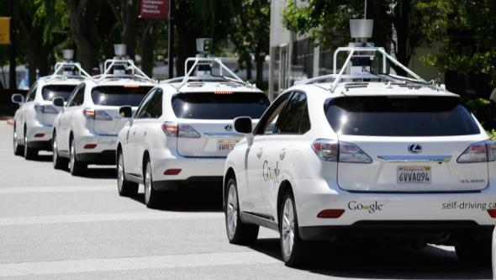

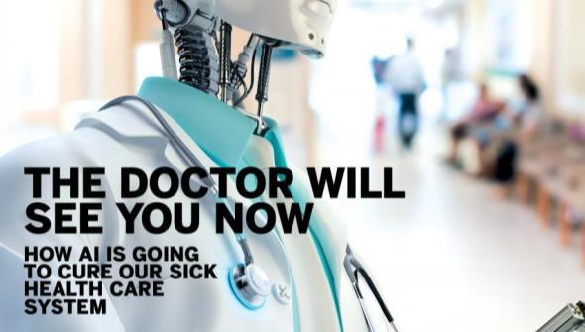

Slide 37


Challenges lie upon Artificial Intelligence era
Task for human
Decision-making
Flexible for embracing new concepts
Resolving conflicts
Setting directions
Accessible for everybody in everywhere
Task for machine
Co-existence
A.I. to follow our decision-making process.
Low-level calculation
Real-time big data handling
Let humans do what humans are good at, and machines do what machines are good at.
Simple repetitive works
→ A.I. to support us, not to replace us.
Humans will always be part of the design, and management of the system.
Notes:
Motivation – Why do we need to build an A.I.
Human cannot deal with information explosion; we need ‘sidekicks’.
We can focus on what we are good at, and let machines do what machines are good at.
A.I. built in proper way would enable the aviation industry to embrace new concepts, make it accessible for everybody in everywhere.
In accordance with how civil aviation has been ensured safety and stability, the A.I. shall be managed to not evolve by itself, but to follow human decision-making process.
Therefore, we need data that shows how we have done so far to build A.I. that think in our way.

Slide 38
Conclusion: Innovation
Delusion vs Optimism
Knowledge and Roadmap: Know what it is / How to achieve it / Which direction to go
The safest aircraft?
The airplane on the ground is safe, but that is not what airplanes are built for
Innovative mind
Things are changing very fast, and going to be even faster.

Slide 39















Artificial Intelligence is open to everyone.
→ You don’t need money to start your own Machine Learning
Education
Development
Open Library
Open Codes

